Slide 1
Titanic Data Analysis
By
Tobi Bakare & Uditi Shah

Slide 2
Table of content
Team’s individual skills
Overview of our project
Source of our data
Acquisition approach
Dataset Demonstration
Result
Potential usage of our dataset
Distribution plan of your data
Challenges & issues
Limitations we encountered

Slide 3
Team Skills
01
02
Uditi Shah
Previous Degrees:
B.Sc in Data Science
Current Degree:
M.S in Data Science
Tobi Bakare
Previous Degrees:
B.Sc in Information Systems
Current Degree:
M.S in Data Science

Slide 4
Introduction
Our motivation to delve into this information is driven by a desire to unearth hidden trends, investigate demographic differences, and gain a more nuanced understanding of the human dynamics entwined with the Titanic disaster. Our exploration takes a unique approach by employing social network analysis. By understanding the key figures within the social network of the Titanic, we aim to unveil potential leaders, collaborators, or influential individuals during the incident. To make the most of this dataset, we chose the following questions:
Who were the most central or influential individuals in the Titanic social network based on their connections?
Using cluster analysis with the help of similar characteristics such as age, cabin, or gender. Analyze the passengers that would most likely survive.
Create social networks for the first seven families (male, female and children with the same name and similar cabin location)
Find the ten actors with the highest degree centrality amongst the first 20 families in the data set. (Might require drawing out social networks)
Did upper-class passengers exhibit different social network structures compared to lower-class passengers?
Can family structures be detected within the social network, and how did these contribute to survival?
Notes:
…

Slide 5
Source of data & Acquisition
For this project, we will utilize the provided Titanic dataset (titanic.csv.zip). The dataset includes information about passengers such as their names, ages, genders, classes, cabins, fares, and survival outcomes. It is a comprehensive source for exploring social relationships among passengers during the Titanic disaster.
Using the following methodology to help us in the data set implementation;
Data Preprocessing:
• Handle missing values, clean and standardize data.
• Extract relevant features for social network construction.
Social Network Construction:
• Define nodes as individuals and edges as connections (e.g., shared cabins, familial relationships).

Slide 6

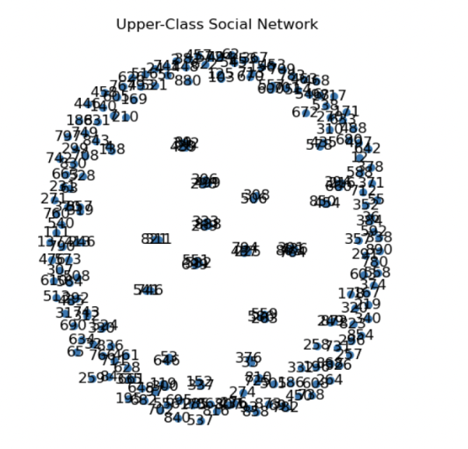
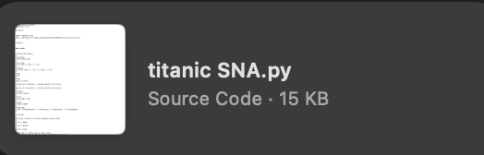
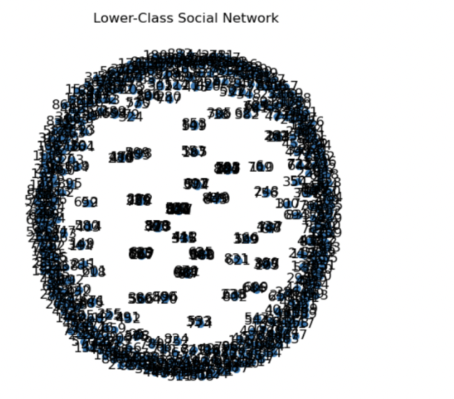
Data Demonstration
Notes:
*

Slide 7
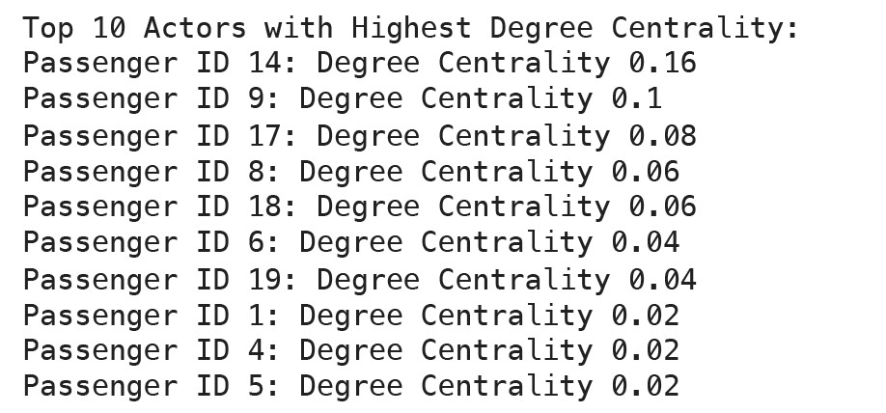
Result
Who were the most central or influential individuals in the Titanic social network based on their connections?
-The most central or influential individual in the Titanic social network based on their connections is Sage Mr George John Jr.
Using cluster analysis with the help of similar characteristics such as age, cabin, or gender. Analyze the passengers that would most likely survive.
-The passenger that is most likely to survive is a woman who is 26 years old. We were not surprised by this because women and children are the first to be evacuated in this situation. The top survival possibilities were women who ranged from 14-40 years old.
Find the ten actors with the highest degree centrality amongst the first 20 families in the data set. (Might require drawing out social networks)
-

Slide 8
Result
4.) Create social networks for the first seven families (male, female and children with the same name and similar cabin location)
-This social network graph represents the relationships among the first seven families based
on the criteria of having the same last name and similar cabin locations. Each node in the
graph represents a passenger, and edges connect family members who share the same last
name. Nodes that are connected by edges represents family members who meet the
specified criteria(same last name and similar cabin locations).
5.) Did upper-class passengers exhibit different social network structures compared to lower-class passengers?
-The upper-class passengers definitely exhibit different social network structures compared to lower-class passengers because its network appears less dense compared to the lower-class network. there are less interactions in the upper class as compared to the lower class.
6.) Can family structures be detected within the social network, and how did these contribute to survival?
-The family structures shown in this analysis are not fully clear as to the type of members but the survival does not have a defining factor for family surviving. The analysis does show survivors with the number of family survivors that could be used to keep track of every member on board in the search.

Slide 9
SHARING PLAN & FUTURE WORK
Exploring additional data sources that may offer access to restricted data points that show better connectivity between the relationships sharing information, while adhering to privacy laws and ethical standards.
Enhancing data cleaning and preprocessing techniques to address inconsistencies and missing data, ensuring robust analysis despite limited data points.
For sharing this data, we would want to present it in a clearer form on kaggle or with excel charts to better visualize results.

Slide 10
Challenges & issues
  Data Accessibility
  Limited Data Points
  Data Quality and Consistency
Inconsistent Data
  Timeout Error
Notes:
*...

Slide 11
Limitations
Dataset use can also have certain limitation to its use that include:
  Scope Data
  Privacy Concerns
  Very unique incident
  Applying it to other events
While some of these limitations are necessary to maintain certain privacy laws but having more access to fuller and more detailed datasets of the titanic incident could have helped in answering our questions more in depth and maybe helped in figuring out more family connections or other connections from the members on board.
Notes:
*....

Slide 12
Conclusion
As we present these results, we invite you to journey with us through the interconnected web of individuals aboard the Titanic. The findings we unveil not only contribute to historical understanding but also hold potential insights applicable to contemporary studies on disaster response and community resilience.
Thank you for joining us on this voyage into the past, as we strive to make sense of the human stories woven into the fabric of the Titanic's tragic tale.

